Slide 1

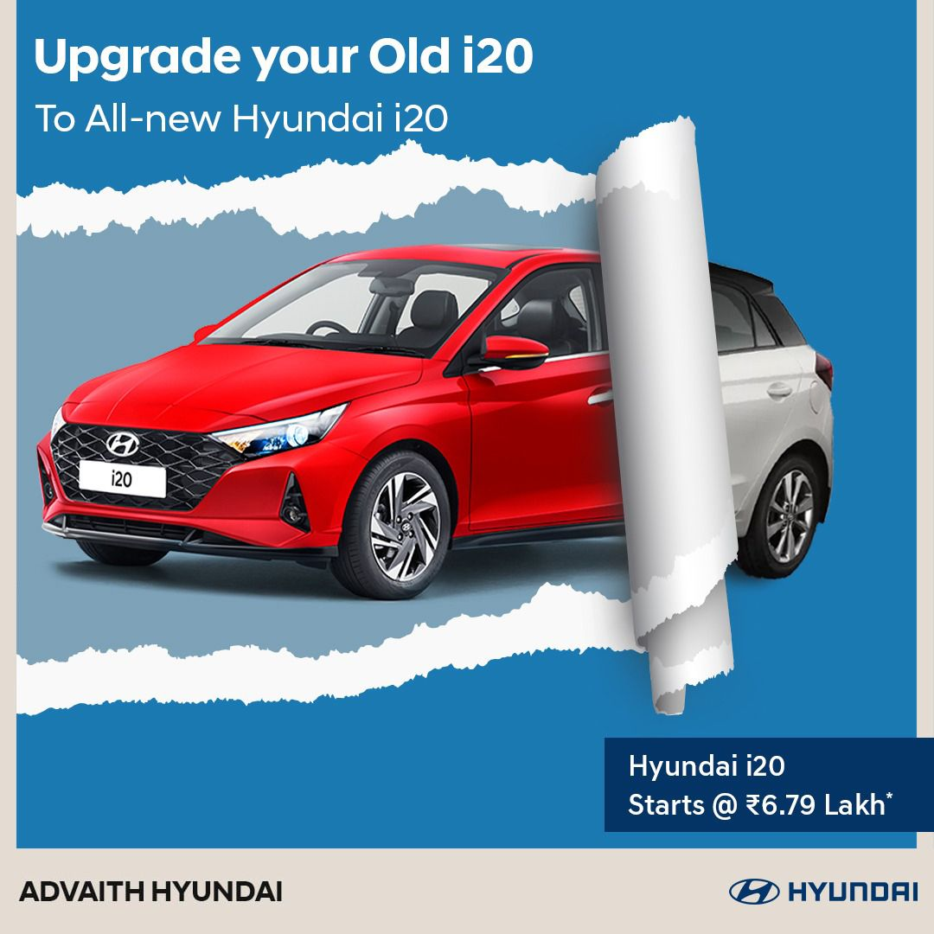
Project
SQL
Car Data
Analysis - UK
----------------
Vishal_M

Slide 2
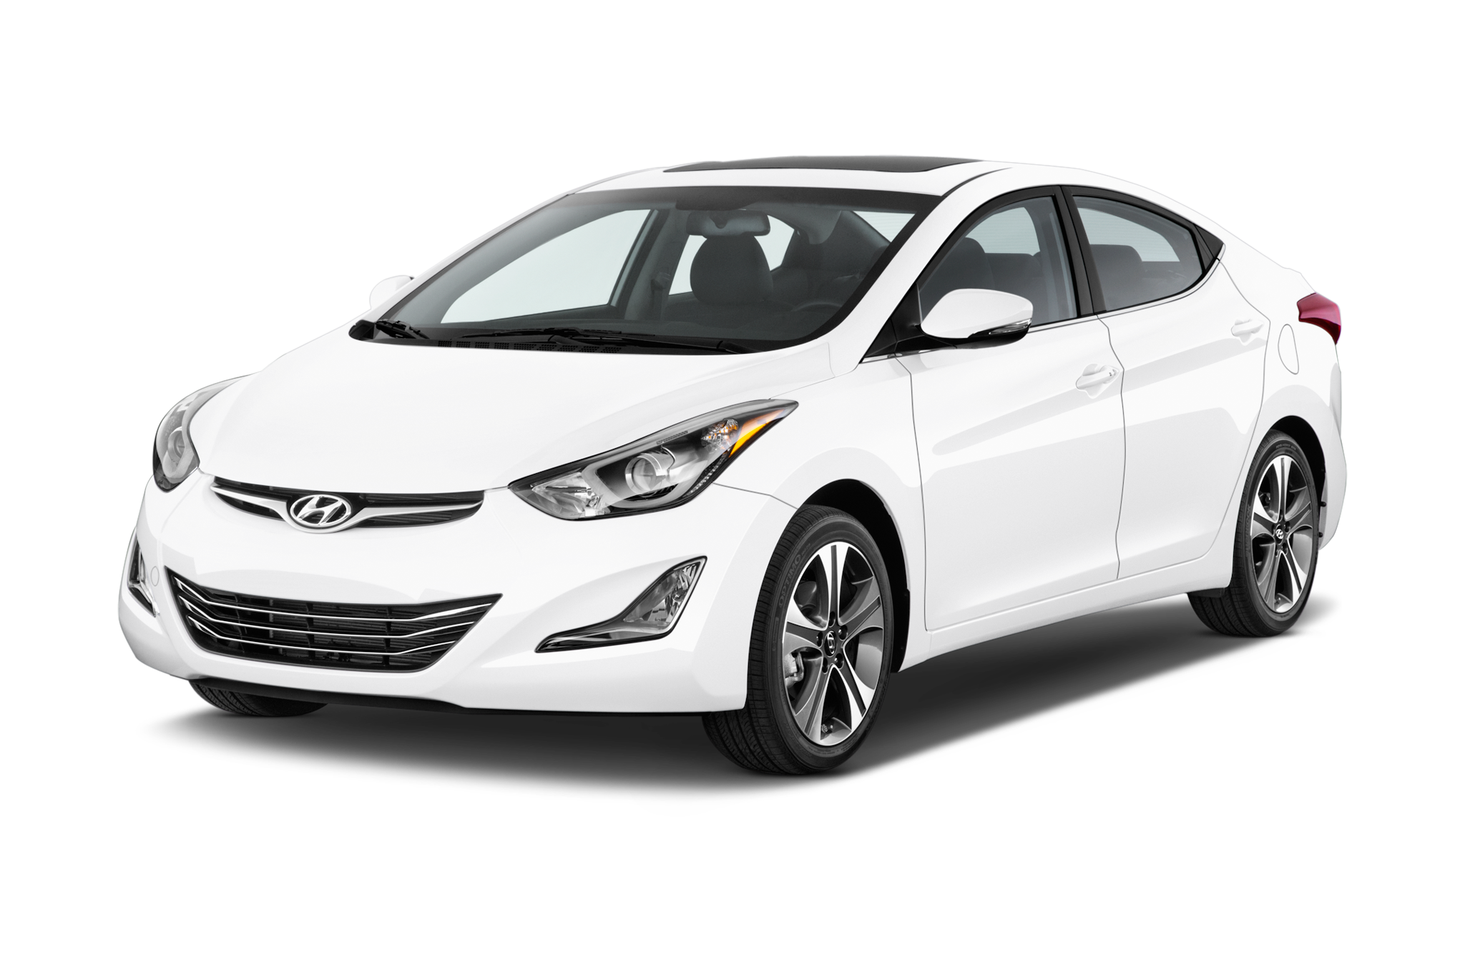
SALES CROSS BRANDS
Market level Sales across each brands we are at the top 4 among the leading brands

Slide 3







Sales Graph for each year
4860
Happy Clients
80
Million dollars

Slide 4
This shows as the top sales and unit sold foe each model

Slide 5
Type of Fuel type Sales Across Year
This shows as the customer preferred fuel-type from our past year

Slide 6
MOST PREFERRED TRANSMISSION AND FUELTYPE
This shows as the customer preferred fuel-type across transmission

Slide 7
Type of Avg Fuel Efficiency of the our models Sold Across Year
We can observe here that avg fuel efficiency for each year for our fuel variants

Slide 8
Efficiency across each Transmission
We can observe here that avg fuel efficiency for each transmission for our fuel variants

Slide 9

Unit Sold For Each year

Slide 10
Sales across each model in each year

Slide 12
Most Preferred Models

Slide 13
Mileage of Preferred Models

Slide 14
Financial Expenditure for some of the recent year Models

Slide 15
Comparison of Financial Expenditure Towards UK Captia
Of Top Models

Slide 16
Conclusion
A Glimpse From Stats
From the above comparison we can see that the petrol variant is optimized well in different models especially in manual transmission
Low and medium level Engine size will help to provided high efficiency
And we can see that these are the most preferred model is top among efficiency and it is also a bit costlier when compared to other variants based in recent years
View Points
We can go for petrol and Manual variants in similar to model I10 and some models followed by i20 and Kona some good stats.
Or else the top performer Tucson can be improvised in efficiency and some fuel-type variants also may give some good hype for it
Additional Fuel-type variants have gained sales in overall market cap

Slide 17

THANK YOU
By- Vishal M

